Slide 1
Lopes Manufacturing: Security Program Roadmap
Student’s Name
Institutional Affiliations
Date
Notes:
The purpose of this presentation is to explain the security program roadmap for Lopes Manufacturing Company.

Slide 2
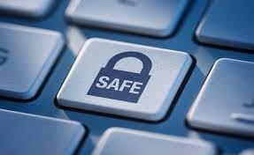
Design Elements of the Program
Security awareness
Incident management
Risk management
Disaster recovery
Identity and access management
Provisioning process
Security operations center
Security engineering
Policy management
User permission
Notes:
Lopes Manufacturing security program comprises security awareness which will require the employee to be informed of the threats and risks in the security system. Then the security team will have to respond to the incidences and evaluate the risks to reduce the level of damage. The access to the system will then be restricted to only those permitted individuals. employees and clients will then be provided with a suitable environment to share the orders and payment details. The security team will use the operations strategies to reduce the damages by monitoring the system. Security engineers will be trained to provide essential services of security as well as the development and upgrade of the Lopes Manufacturing system. The important policy will be developed by the security and legal team of Lopes Manufacturing to ensure the legal matters are followed. Different users will be provided with different permissions to ensure only those permitted employees can view the trade secrets and financial details of the company.

Slide 3
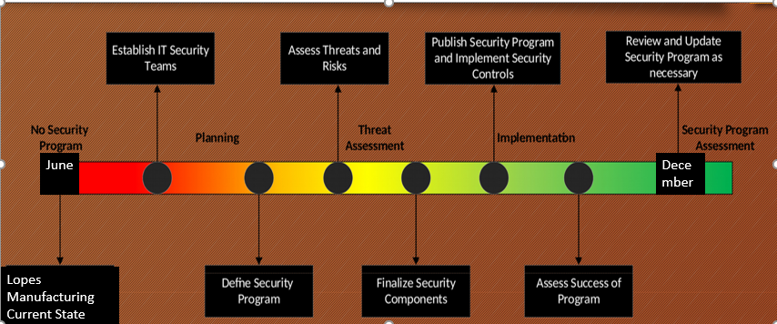
Implementation Timeliness
Notes:
The implementation time for the timeliness program will be done FROM June to December. Therefore, in June there is no security program in Lopes Manufacturing. In this stage, Lopes systems are vulnerable to threats and can lead to immense damages. The program will start by making employees aware of the risks and threats in the system. Then information technology teams will be created and trained on essential security strategies. The planning stage will start and the security program will be defined then evaluate the threats and risks. The next step will be threat evaluation happening between September and October, which will be to finalize security elements and publish the program and execute security controls. Finally, is to implement the program and evaluate the success of the program then review and update the programs where necessary and continue the assessment.

Slide 4
Roles and Responsibilities
Security operation center in the information technology department will deal examine the risks and execute the program
Information security officer will create and plan the program and organize the team to guarantee successful incorporation
Project manager will plan all the logistics and conduct evaluation of the security program
Notes:
Lopes Manufacturing department responsible for the implementation of the security program is the Information Technology department. Information Technology Department will have to play the role of executing and maintaining organization by developing policies, strategies and measures. Li et al. (2021), claimed that IT Department is responsible for creating security awareness and ensure every employee realizes their role in maintaining security. The information security officer (ISO) is responsible for the creation, planning and execution of the security program. ISO is also responsible for recognizing the threats, evaluate vulnerability, regulate risk, implement control approaches and monitor and examine the security program. The project manager is also required to gather the teams, plans all logistics and handle evaluations of the security program after it has been executed.

Slide 5
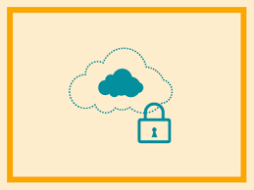
Security Controls
VLANs will be utilized to isolated different departments (Mehdizadeha et al., 2017)
Badges will be created to control authentication access to Lopes information departments
Server back-ups and network dismissals for ideal up times
personal Identifiable Information will be implemented in locking drawers and server rooms
Security policies will be enforced including the ECPA
Notes:
Several security controls will be implemented in Lopes Manufacturing. For example, the Virtual Local Area Network (VLANs) will provide immense benefits in securing the different department's information in the system. First, VLAN will ease administration by grouping different departments. Also, VLANs enhances the implementation of security policies by constraining and distributing domains and end-stations are prohibited from listening to or obtaining broadcasts not planned for them (Mehdizadeha et al., 2017). also, Badges will be created to deal with the authentication access in Lopes Manufacturing this will reduce the entrance of unauthorized individuals in departments that are not required. Server backups and network dismissals will be implemented to avoid work delays hence ideal up times created. Another control is the personally identifiable information (PII) will be built in locking drawers and server rooms to avoid the access of unauthorized persons. Finally, is the enforcement of security policies such as ECPA in securing the share information.

Slide 6
Necessary Maintenance
Ensure all biometric instrument and locks are working efficiently
Inspecting physical network equipment and workstations to guarantee suitable operations
Automatic updates implemented on the systems
Advancing the software to achieve Lopes requirement and security practices
Constant monitoring of network traffic and network recital
Notes:
Lopes Manufacturing information security department will arrange the maintenance face in two different categories. The first category will be hardware and the second one will be software maintenance. Furthermore, hardware maintenance will deal with all physical devices and equipment such as computers and locks. For example, ensure there is a biometric instrument and locks are operating efficiently. Also, hardware maintenance will include inspecting physical network equipment such as the routers and servers and guarantee suitable operations. Software maintenance includes automatic updates of the Lopes information system this should be done in the most inactive time in the system such as late at night. Also, advancing the software to meet Lopes’ requirement and security practices as well as constant monitoring of network traffic to identify the threats.

Slide 7

Analysis of Security Failures
Target attacks
Misconfigured systems
End user error (Rajivan et al., 2017)
Notes:
Lopes Manufacturing system is faced with significant security failures, for instance, they can be targeted by attacks that require the IT department to constantly preserve and monitor the attacks including mail phishing and virus attacks. Also, proper security practices should be used in the deployment of the system. Another failure is the misconfigured system which can result in various security risks and susceptibility to attacks, clients and workers information in danger. Another failure is an end-user error which comprises of the employees or customer unintentional actions or failure to perform an action hence resulting to spread or permit a security breach in the system (Rajivan et al., 2017). This will require Lopes to perform training on employees to make them aware of the threats.

Slide 8
Established Laws and Controls
Organize several security controls utilizing a group policy
Recognize ECPA laws and guidelines to properly store and share customers information (Walker, 2018)
Utilize local domain and server manager to effortlessly control user authorizations
Notes:
Based on the previous assignment the law that was established was ECPA which was established in 1986. The law comprises three acts including the stored communication act, wiretap and pen registered act (Walker, 2018). Lopes Manufacturing deals mostly with the communication with customers electronically, therefore, the act will ensure privacy is safeguarded. Another control established is the organization of several security controls by utilizing the group policy. For instance, through VLANs different departments can be separated in their network. Another control is the user permission through the use of biometric and badges. The IT department will also utilize local domain and server manager to effortlessly control user authorizations.

Slide 9
References
Li, H., Yoo, S., & Kettinger, W. J. (2021). The Roles of IT Strategies and Security Investments in Reducing Organizational Security Breaches. Journal of Management Information Systems, 38(1), 222-245.
Mehdizadeha, A., Suinggia, K., Mohammadpoorb, M., & Haruna, H. (2017, December). Virtual Local Area Network (VLAN): Segmentation and Security. In The Third International Conference on Computing Technology and Information Management (ICCTIM2017) (pp. 78-89).
Rajivan, P., Moriano, P., Kelley, T., & Camp, L. J. (2017). Factors in an end-user security expertise instrument. Information & Computer Security.
Walker, J. (2018). The Problem of Privacy: A Legal and Legislative Analysis of the Anticipated Precedent of the CLOUD Act on Data Collection and Access.

